Slide 1


data science program itvitae kickoff
Angel Sevilla camins

Slide 2
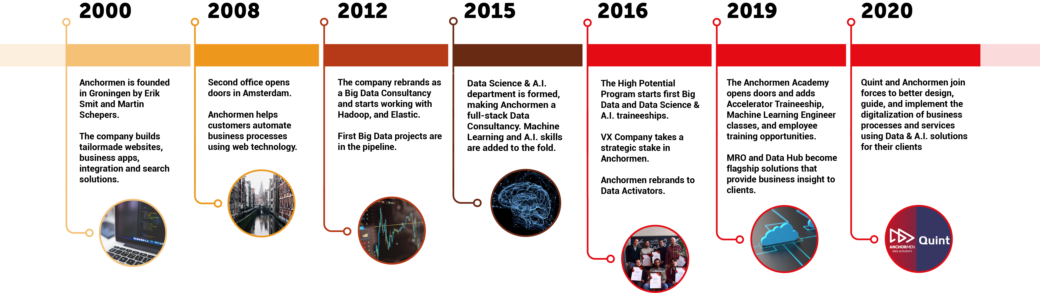
Who are we?
Anchormen is the only full-stack data activation expert offering innovative solutions that help clients transform, innovate and grow.
Founded in 2000; Based in the Netherlands; offices in Amsterdam and Groningen
Innovative minds, team of enthusiastic men and women: Data Engineers, Machine Learning Engineers, Data Scientists, A.I. Experts, Consultants and Project Managers
Building Solid Partnership with our clients and delivering meaningful results for their business

Slide 3


planning
Morning
Presentation
Introduction Data Science
Curriculum
Tooling
Materials
After Lunch
Lab: Laptops Set-up

Slide 4
Presentation

Slide 5

Introduction round
Background, education
Hobbies, interest
Which are you expectations about this course?

Slide 6
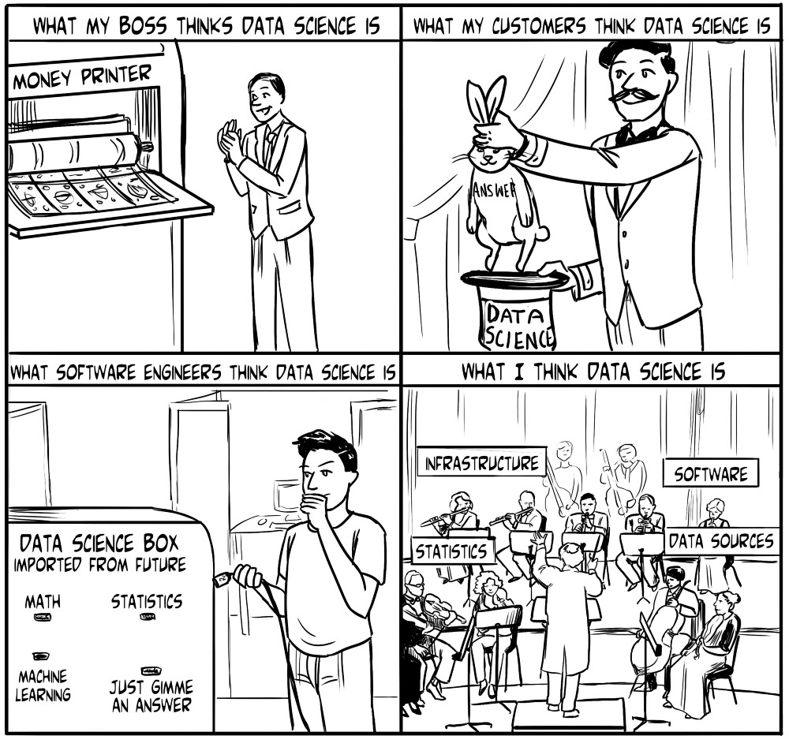
“Data science is the extraction of knowledge from data.”

Slide 7

The Evolution of data science

Slide 8
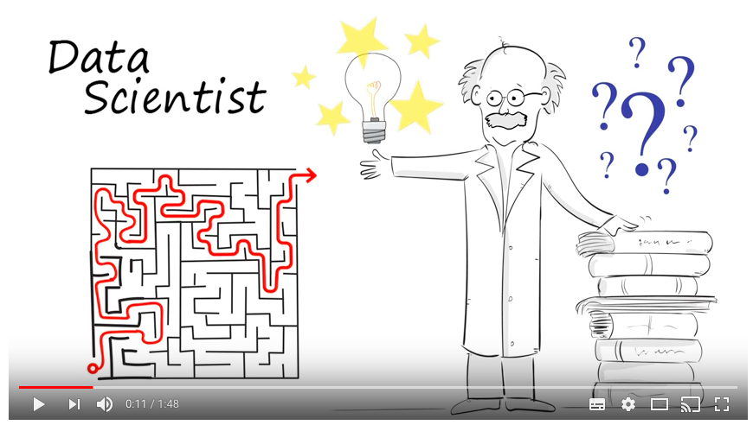
What does a data scientist?
The Data Scientist – 60 Second Data Science: The https://www.youtube.com/watch?v=i2jwZcWicSY

Slide 9
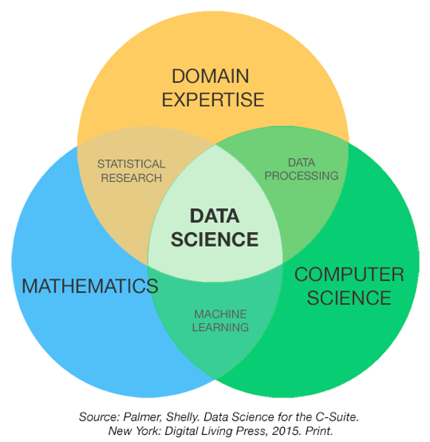
Data science – an overlap of disciplines

Slide 10
The data scientist’s skills
Programming
Defining the Problem
Data Gathering
Data Preprocessing
Mathematics
Data Scientist’s
Skills
Visualization
Statistics
Big Data Engineering
Machine Learning
Communicating Results

Slide 11
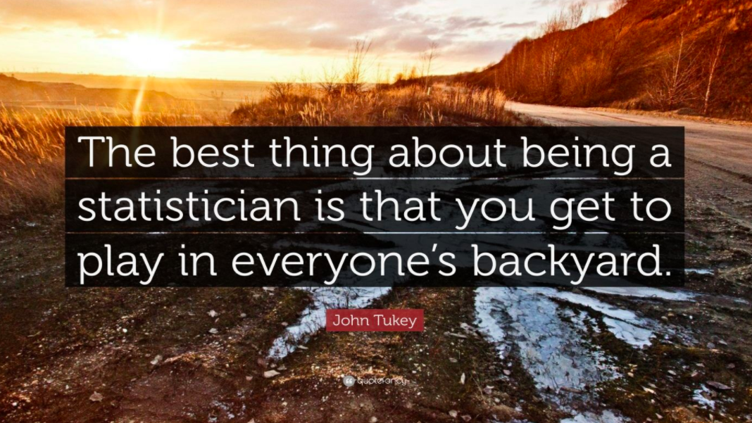
Title
Notes:
Quote certainly also applies to Data Science. Data Scientists work on a broad spectrum of companies Give examples of companies for which we have done assignments.

Slide 12
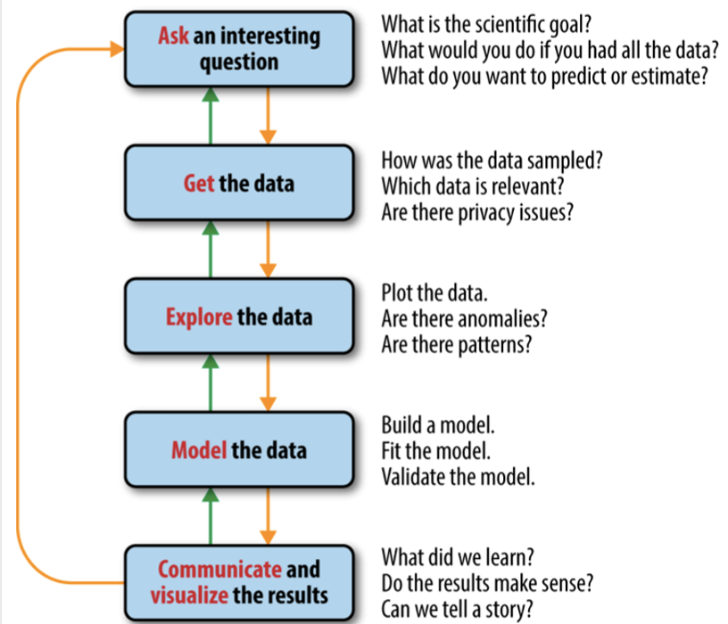
The data science process

Slide 13
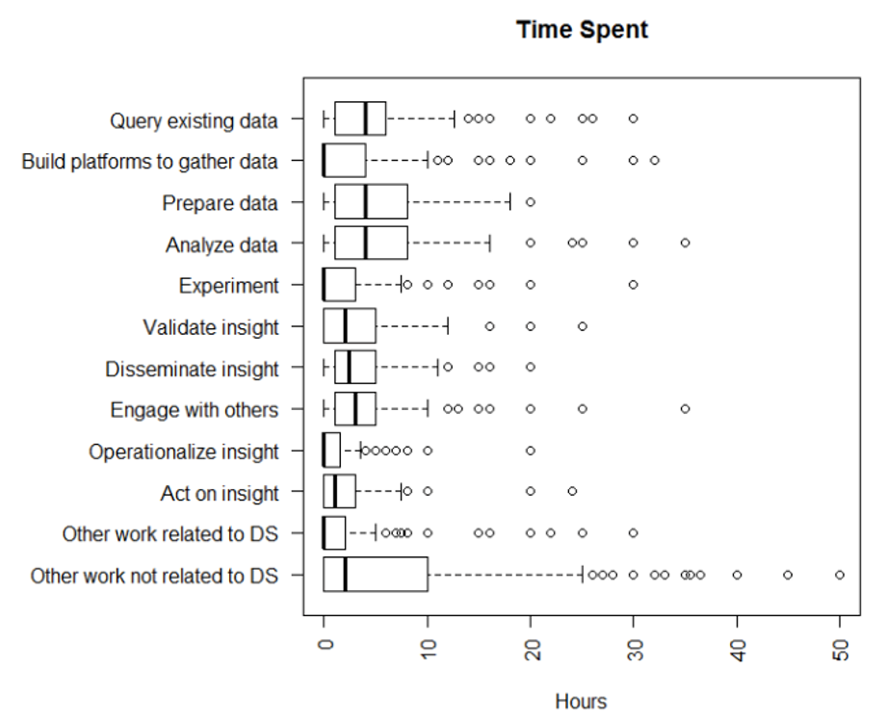
Not every data scientist does the same

Slide 14
AIRBNB data science flavors

Slide 15
What does ‘science’ do in data science?
The scientific method:
Ask a question.
State a hypothesis about the answer to the question.
Make a testable prediction that would provide evidence in favor of the hypothesis if correct.
Or better: try to falsify it.
Test the prediction via an experiment involving data.
Draw the appropriate conclusions through analyses of experimental results.

Slide 16
Curriculum

Slide 17
Curriculum - what's on the program?
4 Modules:
Data Science
Additional skills:
Deep Learning
Natural Language Processing (NLP)
Big Data Engineering

Slide 18
How ARE we GOING TO proceed?
Getting Started: Data Scientist's Toolkit
Build up knowledge and skills in each of the 4 modules
Each lesson is a mix of theory, lab exercises and example cases
In addition, info about best practices, tips & tricks, templates for workflow and code
2 days a week with guidance
2 tests, one after Data Science and other after the rest, equally important.
Interactive, learning from each other
Asking questions is important

Slide 19
Module a – Data science (1)
Date | Weekday | Description
01/Mar/21 | Monday | Introduction and tools setup
04/Mar/21 | Thursday | Python review
08/Mar/21 | Monday | Version Control: git and gitflow
11/Mar/21 | Thursday | Visualization
15/Mar/21 | Monday | Data Preprocessing
18/Mar/21 | Thursday | Web Scraping
22/Mar/21 | Monday | Spatial Visualization
25/Mar/21 | Thursday | Python Machine Learning Basics 1
29/Mar/21 | Monday | Python Machine Learning Basics 2
01/Apr/21 | Thursday | Python Machine Learning Basics 3
05/Apr/21 | Monday | Paasmaandag
08/Apr/21 | Thursday | Local models
12/Apr/21 | Monday | Dimensionality Reduction
15/Apr/21 | Thursday | Support Vector Machines

Slide 20
Module a – Data science (2)
Date | Weekday | Description
19/Apr/21 | Monday | Decision-Regression-Trees
22/Apr/21 | Thursday | Ensemble-Models
26/Apr/21 | Monday | Koningsdag
29/Apr/21 | Thursday | Free
03/May/21 | Monday | Time Series Forecasting with Python
06/May/21 | Thursday | Review
10/May/21 | Monday | Review
13/May/21 | Thursday | hemelvaart
17/May/21 | Monday | Assessment Data Science

Slide 21
Module B – Additional skills (1)
Date | Weekday | Description
20/May/21 | Thursday | Deep Learning with Tensorflow and Keras 1
24/May/21 | Monday | Pinkstermaandag
27/May/21 | Thursday | Deep Learning with Tensorflow and Keras 2
31/May/21 | Monday | Deep Learning with Tensorflow and Keras 3
03/Jun/21 | Thursday | Natural Language Processing 1
07/Jun/21 | Monday | Natural Language Processing 2
10/Jun/21 | Thursday | Docker
14/Jun/21 | Monday | Spark 1
17/Jun/21 | Thursday | Spark 2

Slide 22
Module B – Additional skills (1)
Date | Weekday | Description
21/Jun/21 | Monday | Kubernetes Basics
24/Jun/21 | Thursday | Kubernetes Advanced
28/Jun/21 | Monday | CI/CD
01/Jul/21 | Thursday | Azure ML Studio 1
05/Jul/21 | Monday | Azure ML Studio 2
08/Jul/21 | Thursday | Kafka
12/Jul/21 | Monday | Assessment Big Data
15/Jul/21 | Thursday | Diplomas + ceremony

Slide 23
toolkit

Slide 24






Data science Toolkit
Core toolkit:
Python
Git
Spark
Docker
Tensorflow
Keras
..

Slide 25
materials

Slide 26
DemoS
Working with Jupyter Notebooks
Data Visualization in python
Spatial Visualization in phyton
Machine Learning Basics using Scikit-learn

Slide 27
Lab:
Toolkit setup

Slide 28
toolkit setup
Installing Core Toolkit:
Virtual Box & Ubuntu https://www.virtualbox.org/
Windows WSL2 https://docs.microsoft.com/en-us/windows/wsl/install-win10
Python (Anaconda): https://www.continuum.io/downloads
Docker https://docs.docker.com/get-docker/
Git: https://git-scm.com/downloads
Access to the course materials

Slide 29
Next lesson
Coming Thursday:
Python Review

Slide 30
ADDITIONAL MATERIAL
Pluralsight:
DataFramed podcast
Data Scientists analysis at Microsoft: http://web.cs.ucla.edu/~miryung/Publications/tse2017-datascientists.pdf
50 years of data science: https://courses.csail.mit.edu/18.337/2015/docs/50YearsDataScience.pdf
What is a Data Scientist: https://www.youtube.com/watch?v=iQBat7e0MQs
Data Scientists analysis at Microsoft: http://web.cs.ucla.edu/~miryung/Publications/tse2017-datascientists.pdf
Ciara Byrne = Development Workflows for Data Scientists (Free eBook): https://data-science.github.com/report.pdf

Slide 31
Questions?
Contact:
Head of Data Science: Angel Sevilla a.sevilla@anchormen.nl

Slide 32
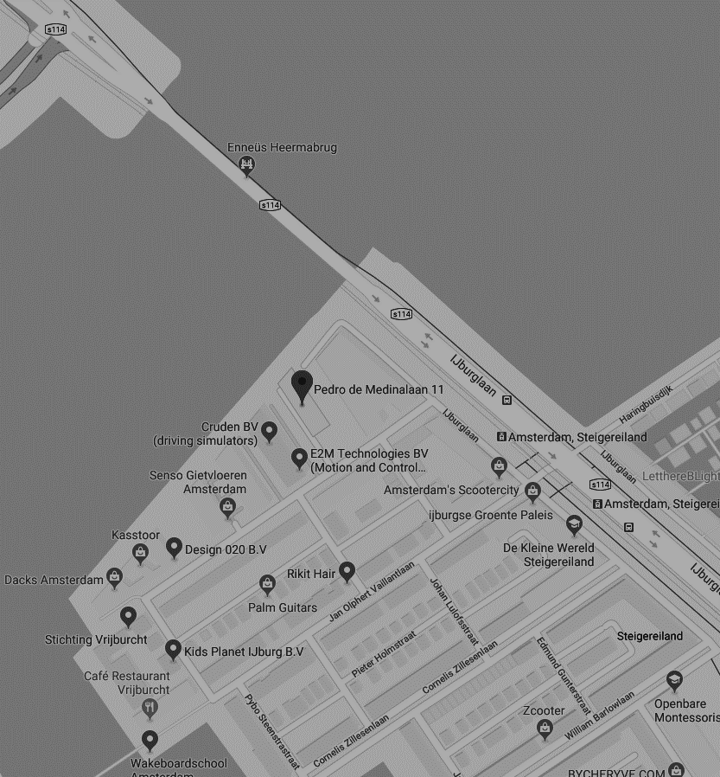
THANK YOU FOR YOUR ATTENTION
Pedro de Medinalaan 11, 1086 XK Amsterdam
020 - 773 1972
www.anchormen.nl

